Slide 1
Citrix Labs
For Long Beach City College Faculty & Staff

Slide 2
Citrix Labs
From this tutorial, you will learn:
How to access Citrix student labs.
How to upload and download documents into the Citrix environment.
How to save files directly to your personal computer from the Citrix environment.

Slide 3
1. Accessing Citrix Student Labs
Step 1:
Using a web browser, such as Google Chrome, Mozilla Firefox, Safari, or Microsoft Edge, navigate to the LBCC homepage https://www.lbcc.edu/
Click on “Viking Portal” located at the top left corner of the screen.

Slide 4
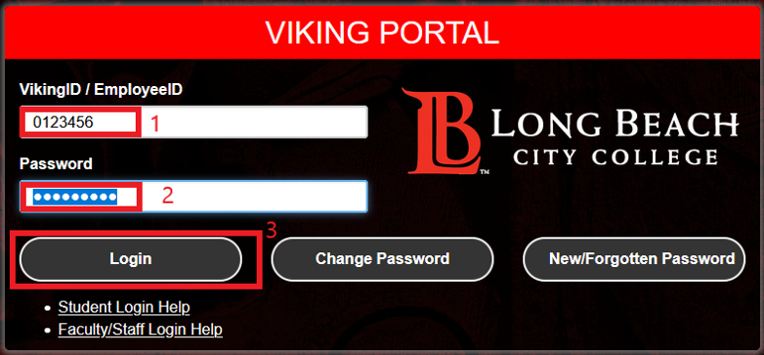
1. Accessing Citrix Student Labs
Step 2:
Enter your credentials to login
Note: If you do not remember your Viking Id number, please contact Admissions and Records Office at 562-938-4485.
Note: If you do not remember your Password, please click the “New/Forgotten Password” button and follow the instructions.

Slide 5
1. Accessing Citrix Student Labs
Step 3:
One you are logged in, you will see a similar page to the one below.
Click on the icon “Citrix Student Labs”

Slide 6
1. Accessing Citrix Student Labs
Step 4:
You will see a loading page come up similar to the picture below.

Slide 7
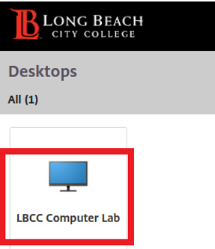
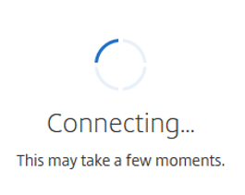
1. Accessing Citrix Student Labs
Step 4:
Click on “LBCC Computer Lab” and wait for the session to load.

Slide 8
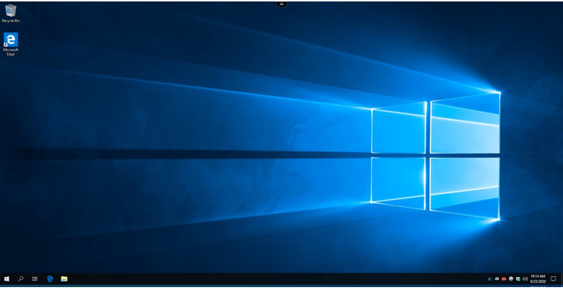
1. Accessing Citrix Student Labs
Once you see this Desktop, you have successfully logged in.

Slide 9
1. Accessing Citrix Student Labs
Step 5:
Once you’re done, log out by clicking the Start menu (Windows Icon) located at the bottom left-hand side.
After, click the person icon and “Sign Out”

Slide 10
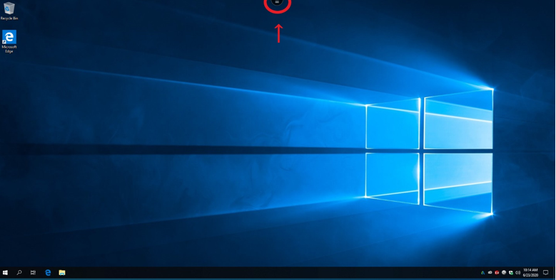
2. Downloading Documents into Citrix
Step 1:
Click on the icon located at the top-middle section of the screen.

Slide 11
2. Downloading Documents into Citrix
Step 2:
You will see a drop-down menu.
To download a document, click on the Download icon.

Slide 12
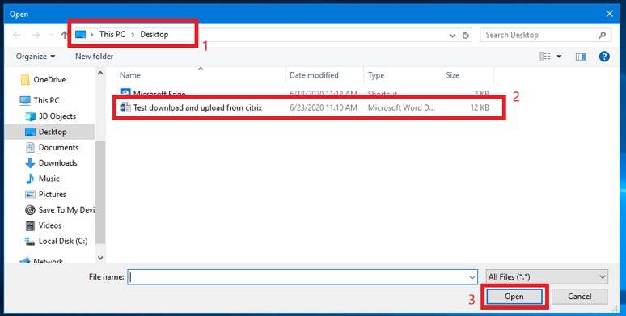
2. Downloading Documents into Citrix
Step 3:
Navigate to the file location which you desire to download.
Select the file and click Open.

Slide 13
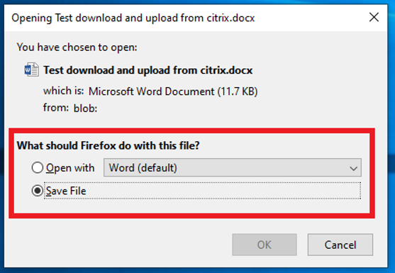
2. Downloading Documents into Citrix
Step 4:
Depending on the browser (Firefox in this example), you may receive a prompt.
Make your selection and click “OK”

Slide 14
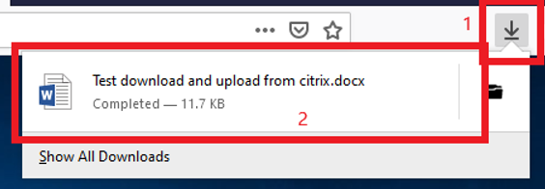
2. Downloading Documents into Citrix
Success!
You will see the file downloaded to your local computer.

Slide 15
3. Uploading Documents into Citrix
Step 1:
Click the icon located at the top-middle section of the screen.

Slide 16
3. Uploading Documents into Citrix
Step 2:
You will see a drop-down menu.
To upload a document, click on the upload icon.

Slide 17
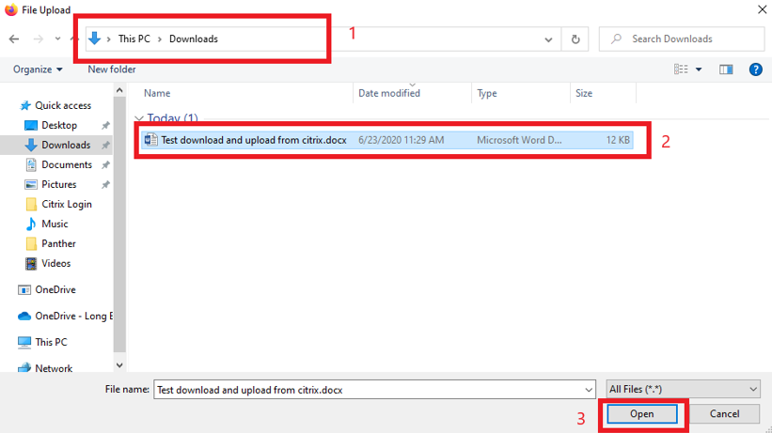
3. Uploading Documents into Citrix
Step 3:
Navigate to the file location which you desire to upload.
Select the file and click Open.

Slide 18
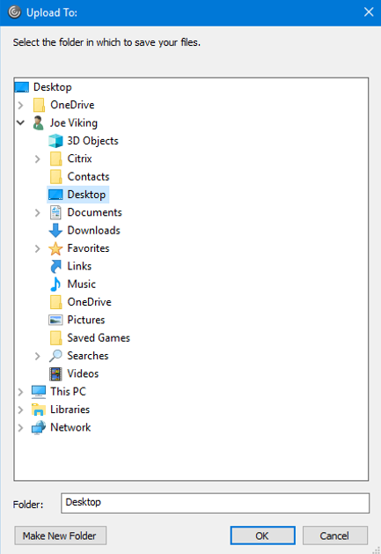
3. Uploading Documents into Citrix
Step 4:
You will receive a second screen to select the location where you would like to save the document.
Select the desired location and click “OK”

Slide 19
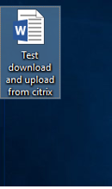
3. Uploading Documents into Citrix
Success!
You have successfully uploaded the file.

Slide 20
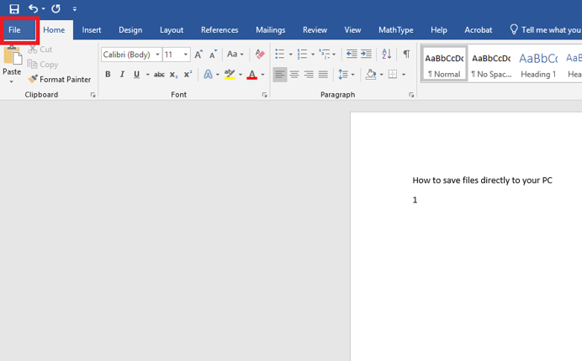
4. Saving Files Directly to Your PC
Step 1:
On the document you would like to save, click “File”

Slide 21
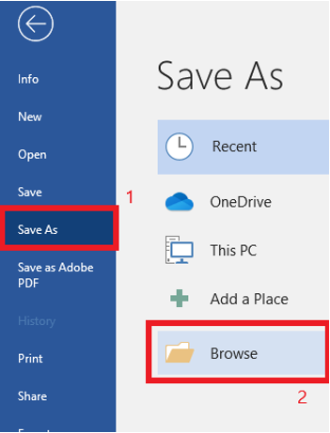
4. Saving Files Directly to Your PC
Step 2:
Click “Save As”, then select Browse.

Slide 22
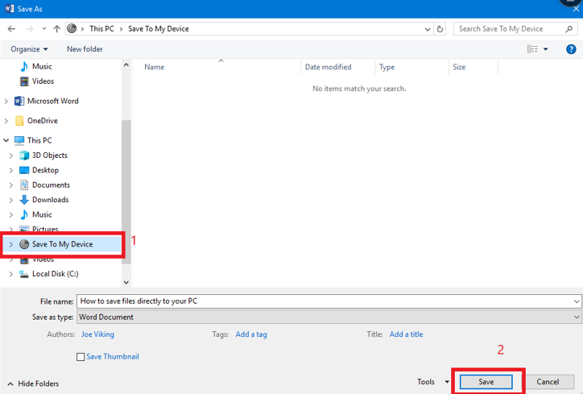
4. Saving Files Directly to Your PC
Step 3:
After a screen pops up, select “Save To My Device” and click Save.

Slide 23
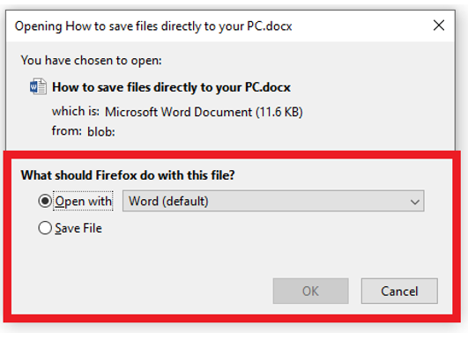
4. Saving Files Directly to Your PC
Step 4:
Depending on the web browser (Firefox in this example), you may receive a prompt.
Make your selection and click ”OK”

Slide 24
4. Saving Files Directly to Your PC
Success!
You have successfully saved the file to your local computer.

Slide 25
Questions?
If you run into any issues, or have questions, feel free to reach out to us!
We are here to help you!
Website: www.lbcc.du/iits
Phone: (562) 938-4357 Email: helpdesk@lbcc.edu

