Slide 1
NEW STUDENT ORIENTATION

Slide 2
WELCOME!
INTRODUCTIONS

Slide 3
What will be covered?
Office
Staff
Services
Eligibility
County Forms

Slide 4
CalWORKs Office Hours
Pacific Coast Campus
GG-217
Monday through Thursday
8:00 a.m. to 6:00 p.m.
Friday 8:00 am to 12:00 p.m.
LONG BEACH CITY COLLEGE ADMINISTRATIVE REGULATIONS ON STUDENT CONDUCT
5012.3 Campus Rules
Section F. Children are not allowed on campus during school hours.

Slide 5
CalWORKs Organizational Chart
Margaret Antonio-Palomares
Assistant Director
CalWORKs
May Lam
Program Student Advisor
Nathanael Grinnell
Grant Assistant II
Ali Raisdanai
Workforce Development Program Specialist
Academic Counselors
Dr. Eric Borin Director ACCESS Programs
Student Assistants
Lisa Roper
Tamara Hom

Slide 6
CalWORKs Services
Academic, Career & Personal Counseling
Workshops
Book Material Requests
Childcare
Work-Study
Professional Development Workshops
On Campus Referrals
Community Referrals
Limited assistance with County issues

Slide 7
Academic Counseling
Completion and/or update Student Educational Plan (SEP)
Information on approved educational & career goal (major)
Explain your major and/or certificate requirements
Review general education requirements
Graduation requirements (grad checks)
Discuss transfer options
Academic and Progress Probation Counseling
Letters of Recommendation (transfer, scholarships or internships)

Slide 8
Personal Counseling
Time Management
Goal Setting
Self Esteem
Life Skills
Health Concerns
Housing Issues
Child Care Concerns

Slide 9
How Can I Get Childcare?
Current Verification of Benefits or Notice of Action on file (every term)
Currently registered in classes
Copies of birth certificate for every child
Have already selected your own provider (Lic. Center , Family Lic. Center or a family member or non-related member)
Complete a Child Care application (available at the CalWORKs office)

Slide 10
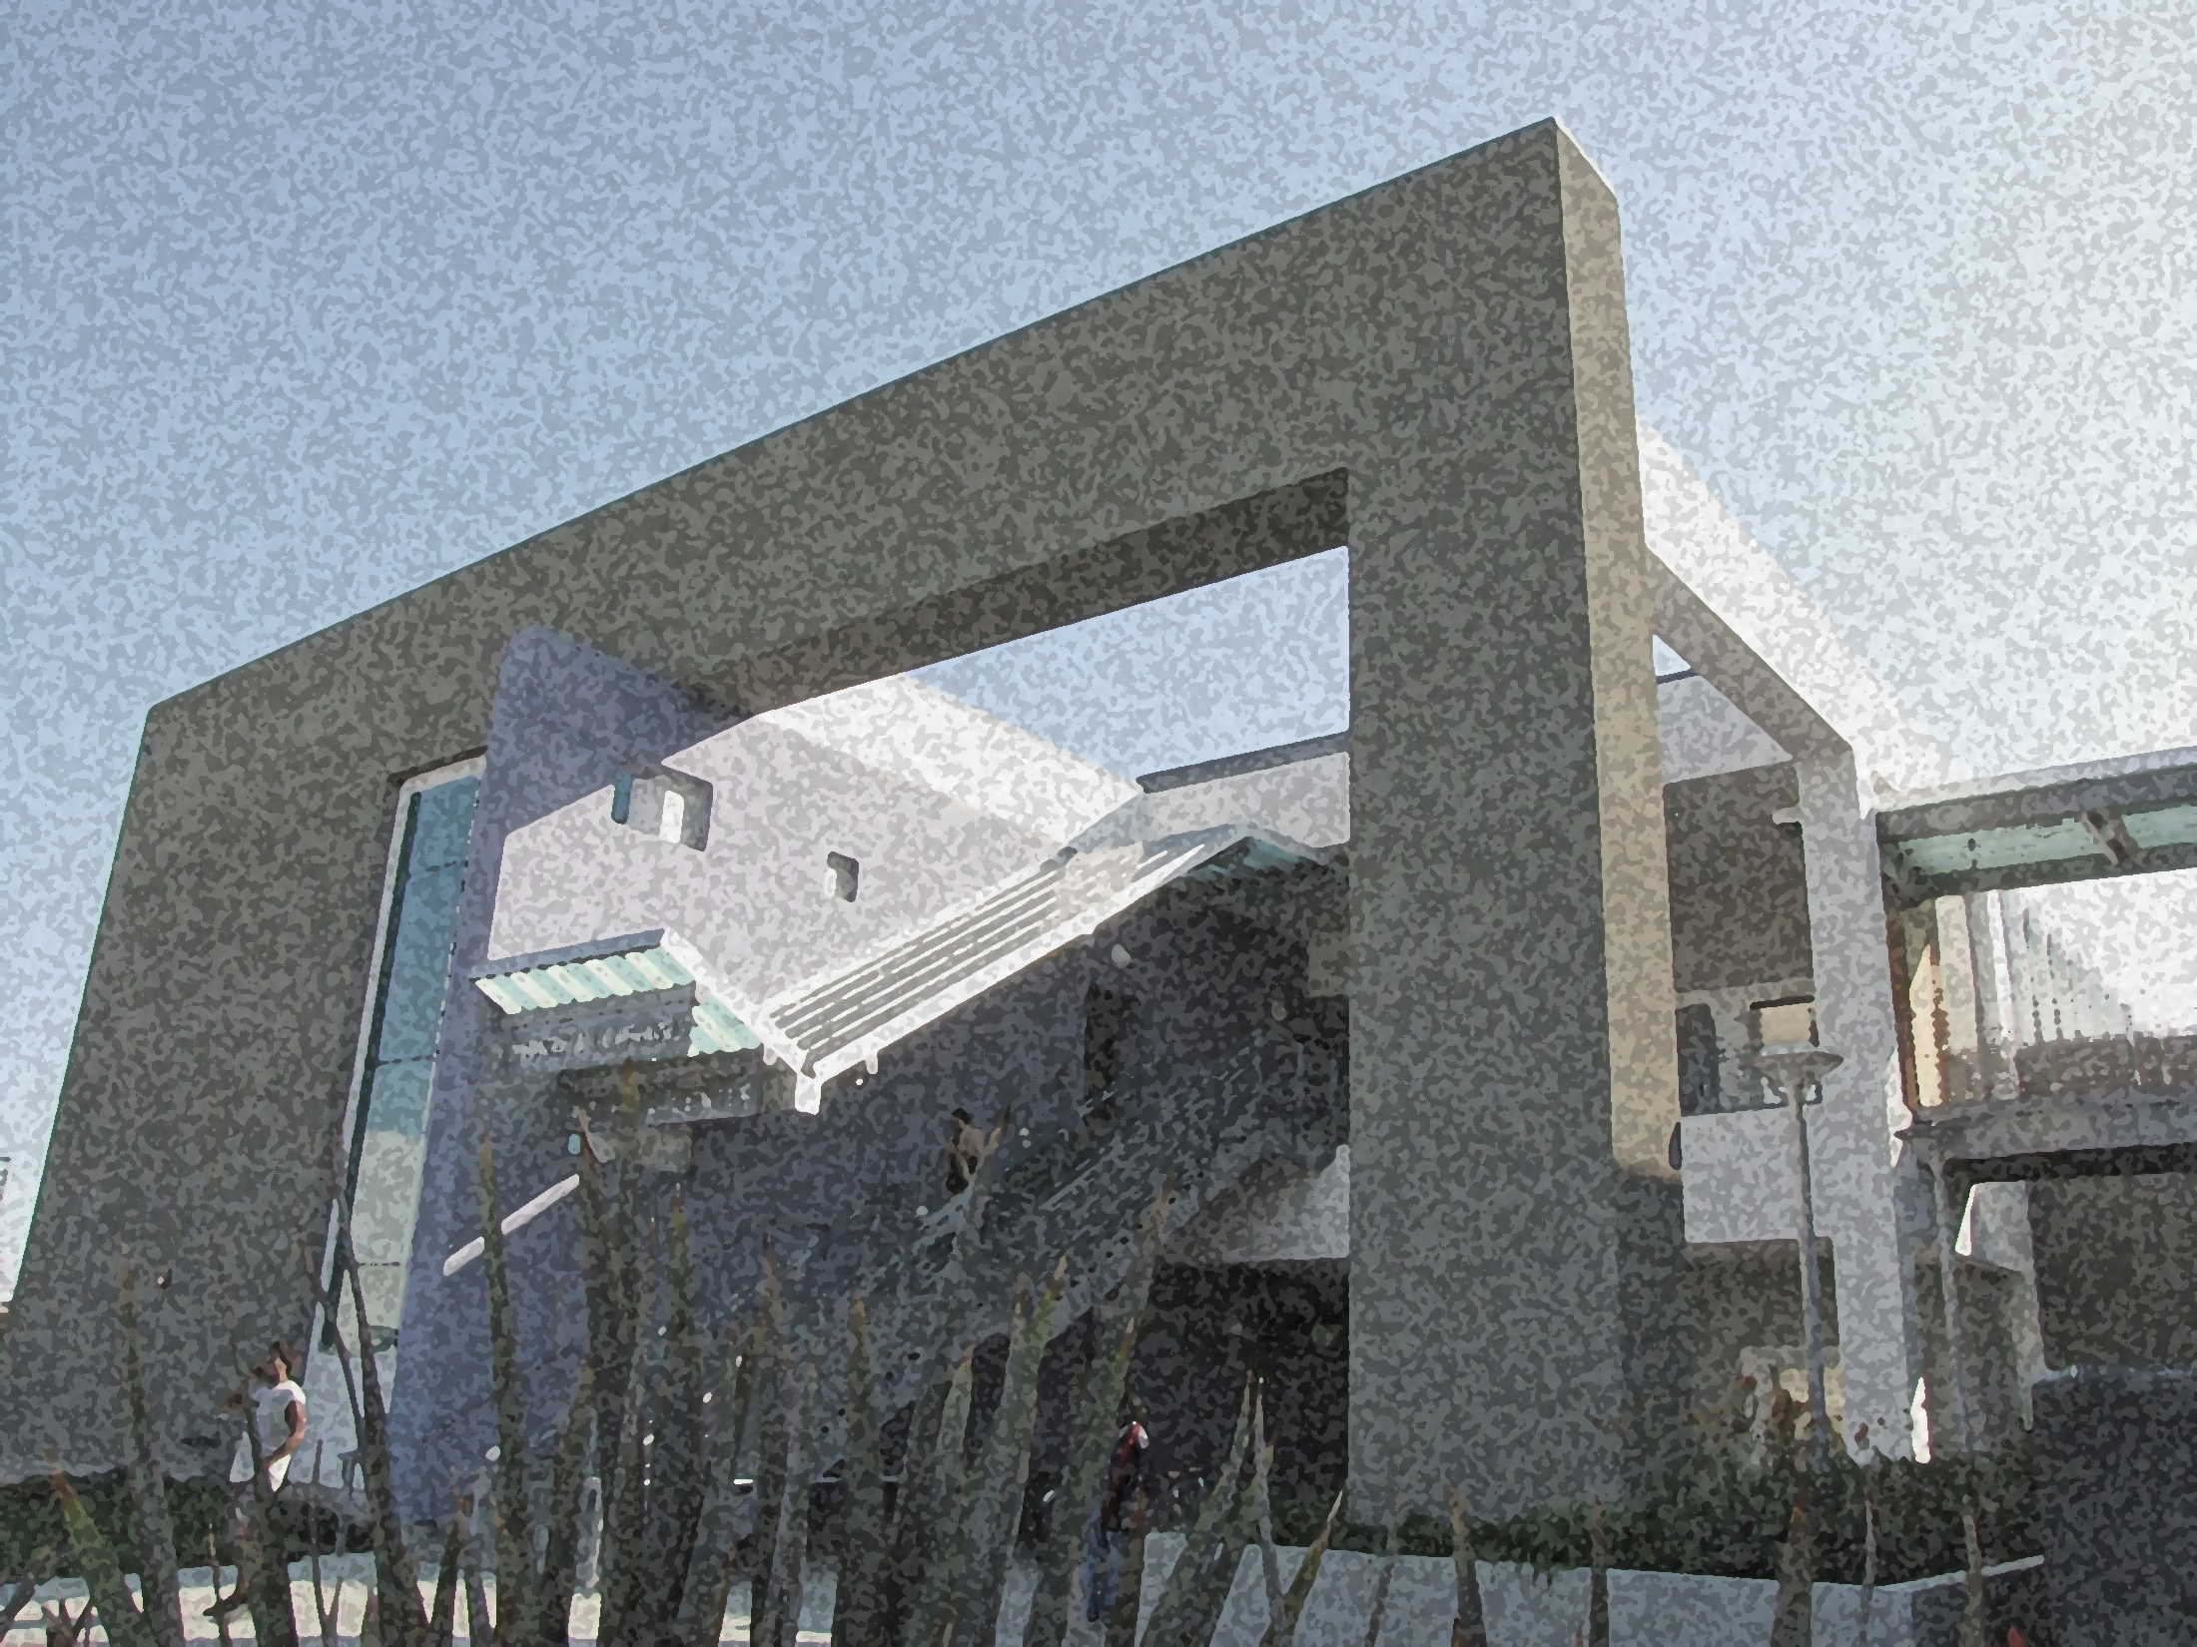
What Is Required Of You?
CalWORKs
Semester Requirements

Slide 11
Paperwork Submission
Submission of all ORIGINAL county forms/documents to your worker is YOUR responsibility.
As a courtesy, we will send an e-copy via email of documents we verified to your Eligibility or GAIN Service Worker. You may request a copy of completed paperwork for your own recordkeeping.
Our office policy: we will NOT fax nor accept faxed documents.

Slide 12
My GAIN Requirements
Welfare to Work Contract
Self Initiated Participant (SIP-GN 6005A)
OR
Vocational Training (VOC-GN 6006)
20/30/35 Weekly Hour Plan
Unless exempt – documentation required
(specialized supportive services)

Slide 13
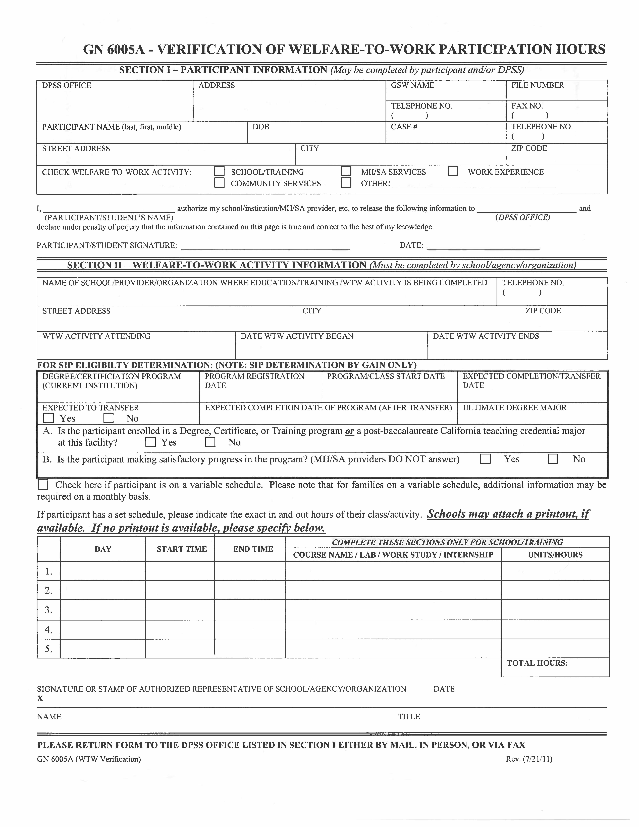
Self-Initiated
Participant
GN 6005A
“SIP”
Bottom left of contract
will tell your status

Slide 14
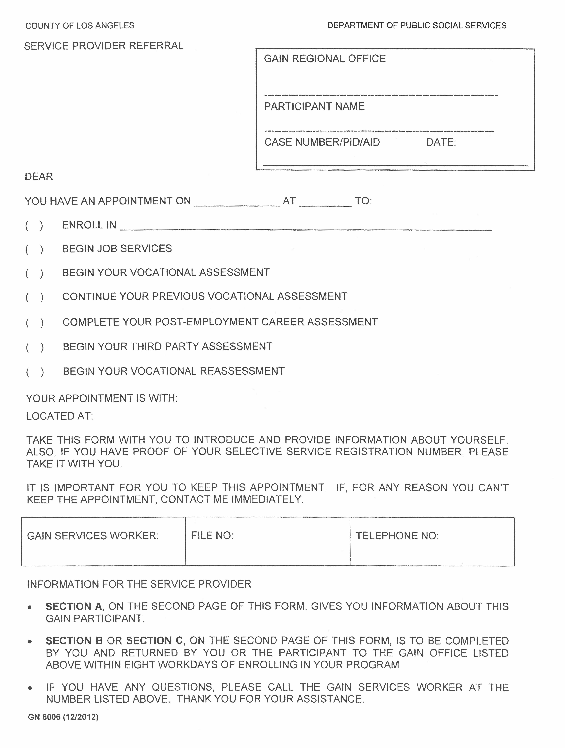
Vocational
Training
GN 6006
“VOC”
Bottom left of contract
will tell your status

Slide 15
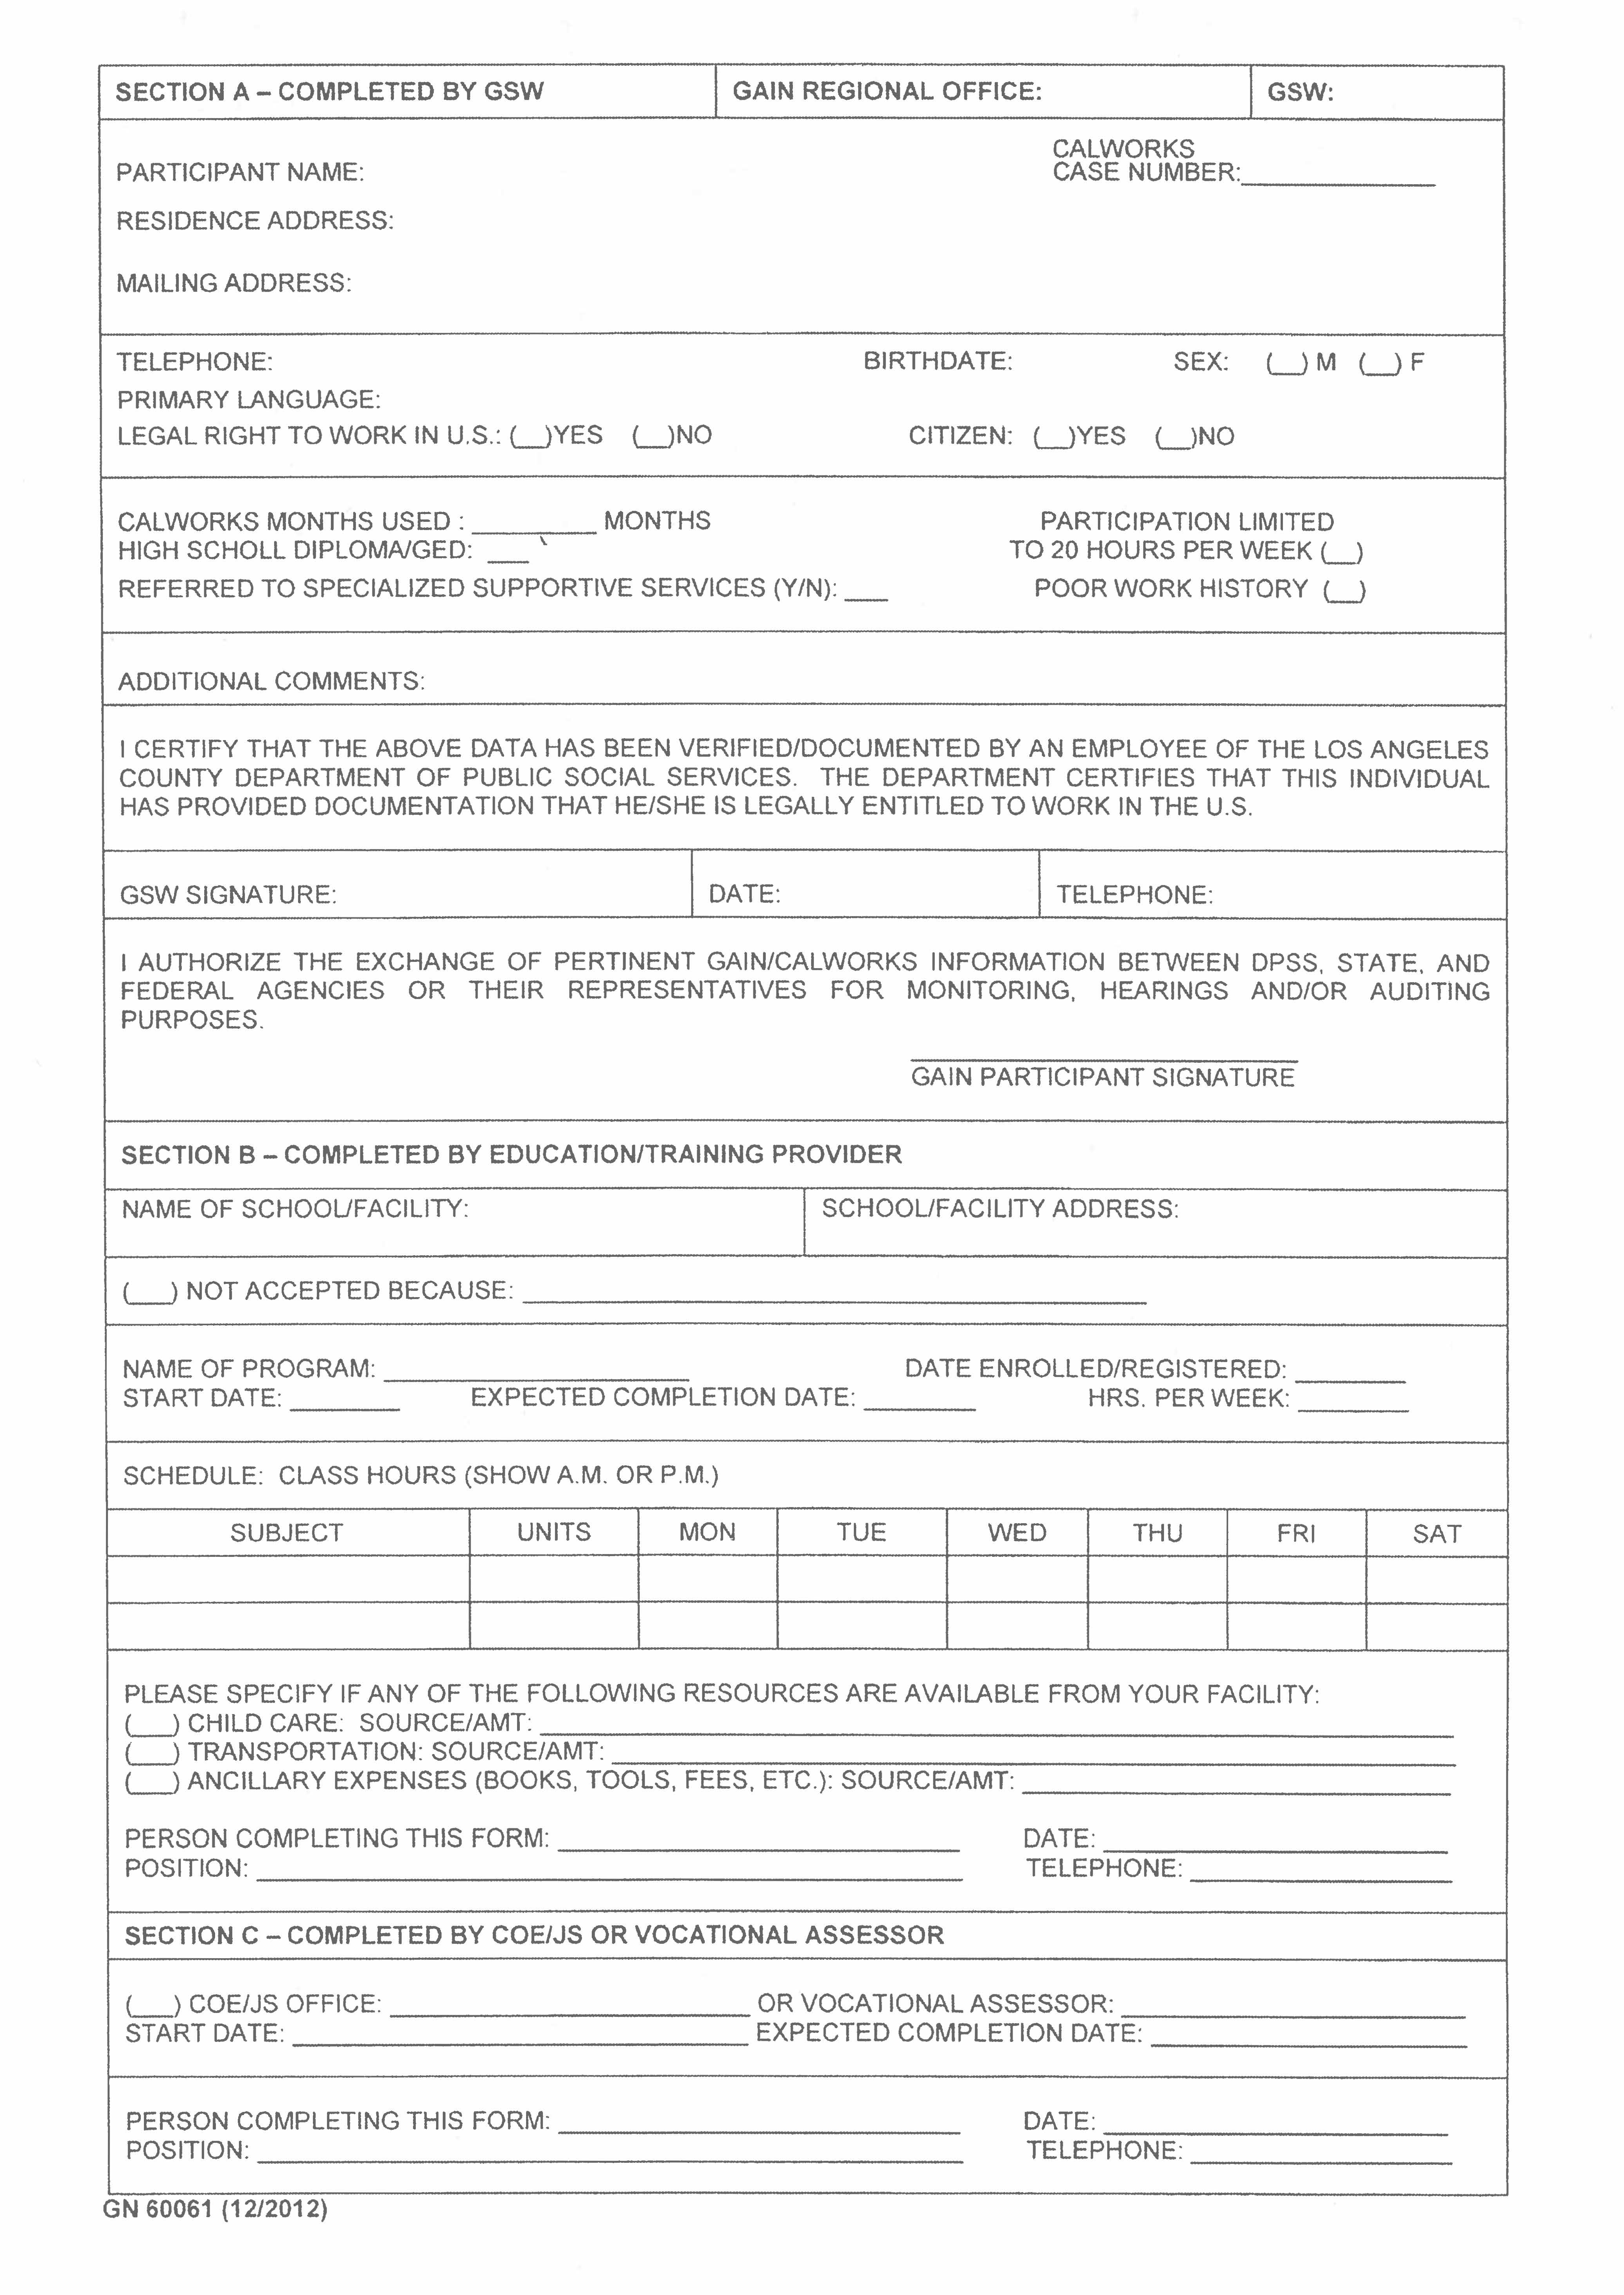
Vocational
Training
GN 6006
“VOC”
2nd page
of contract

Slide 16
CONTRACT OBLIGATIONS
Like yourself, LBCC is under contract and has set expectations from DPSS.
Our contract mandates that we provide services so long as you are successfully completing your program of study.

Slide 17
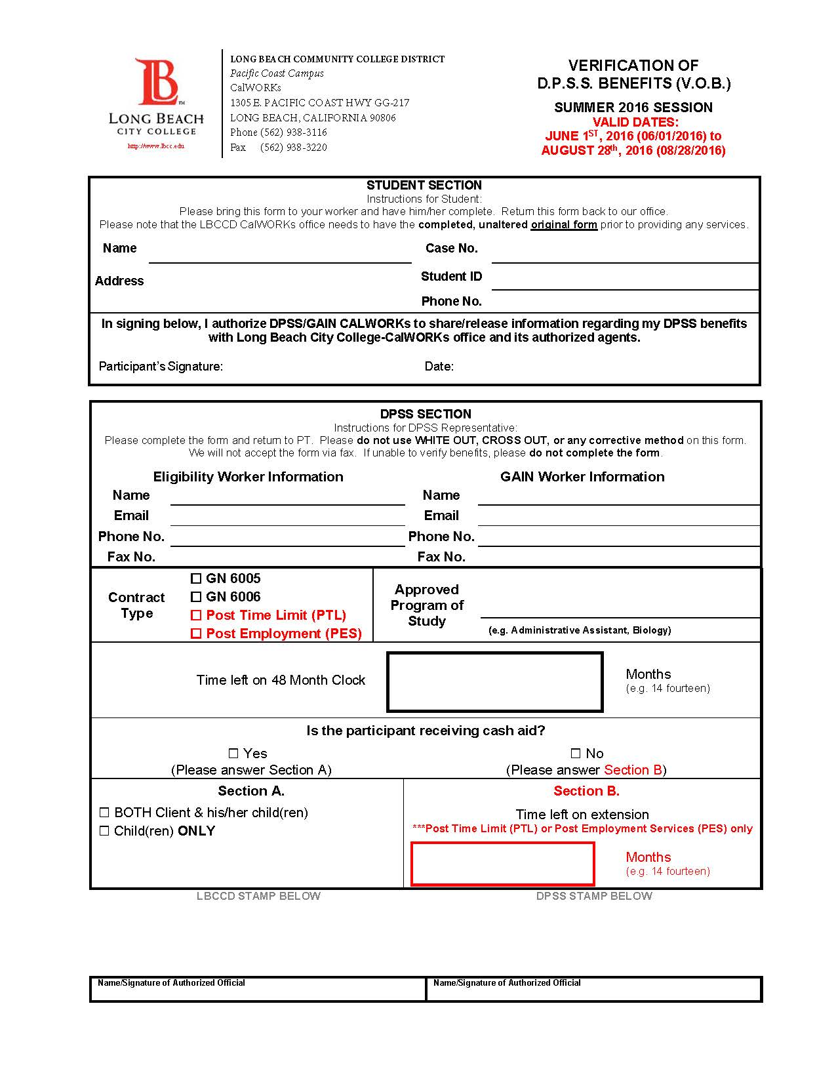
VERIFICATION
OF BENEFITS
“VOB”
Every semester you must provide a current Verification of Benefits that confirms YOU (not just your children) are receiving cash aid and have an active timeclock.
We will no longer accept Notice of Action or DPSS YBN (Your Benefits Now!) printout in lieu of the VOB.

Slide 18
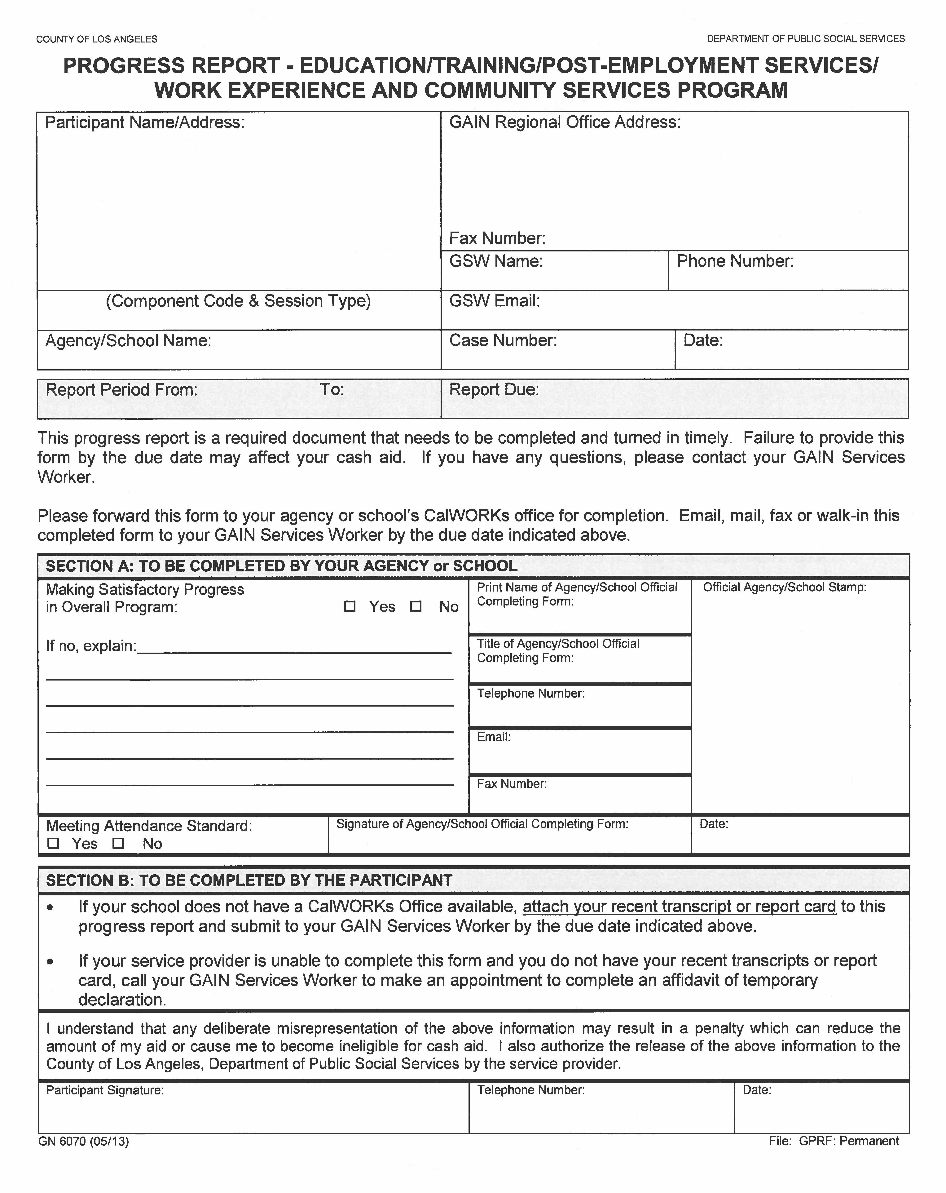
PROGRESS
REPORT
GN 6070
“PGR”
The GAIN Progress Report is mailed out to students about every 3 months (dates are specified by GAIN)
Appointment Required

Slide 19
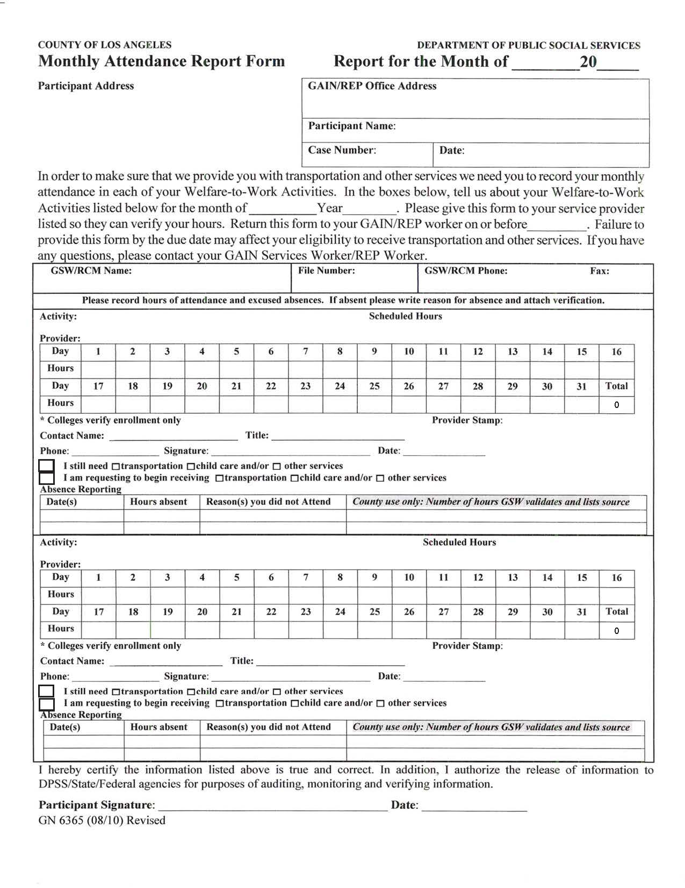
MONTHLY ATTENDANCE REPORT
“MAR”
Monthly Attendance Report is completed every month
C.W. Staff verifies enrollment only
Activity hours to be completed by student
Drop In Ok.

Slide 20
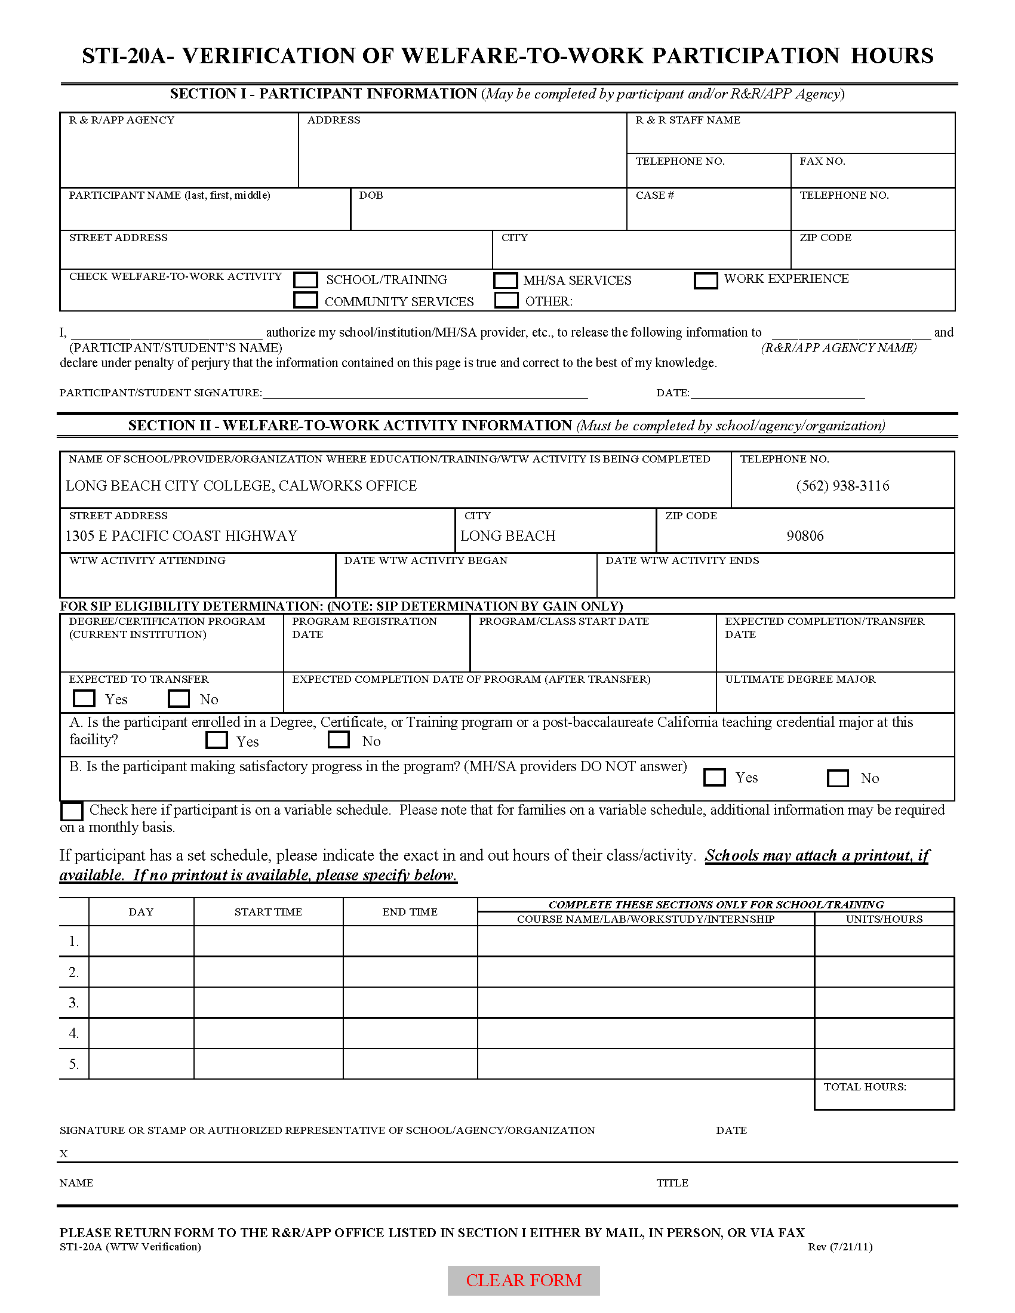
Training
Verification
STI-20A
Must be completed every semester
Only for child care purposes
Must have current eligibility
Must be registered in classes
Drop In OK

Slide 21
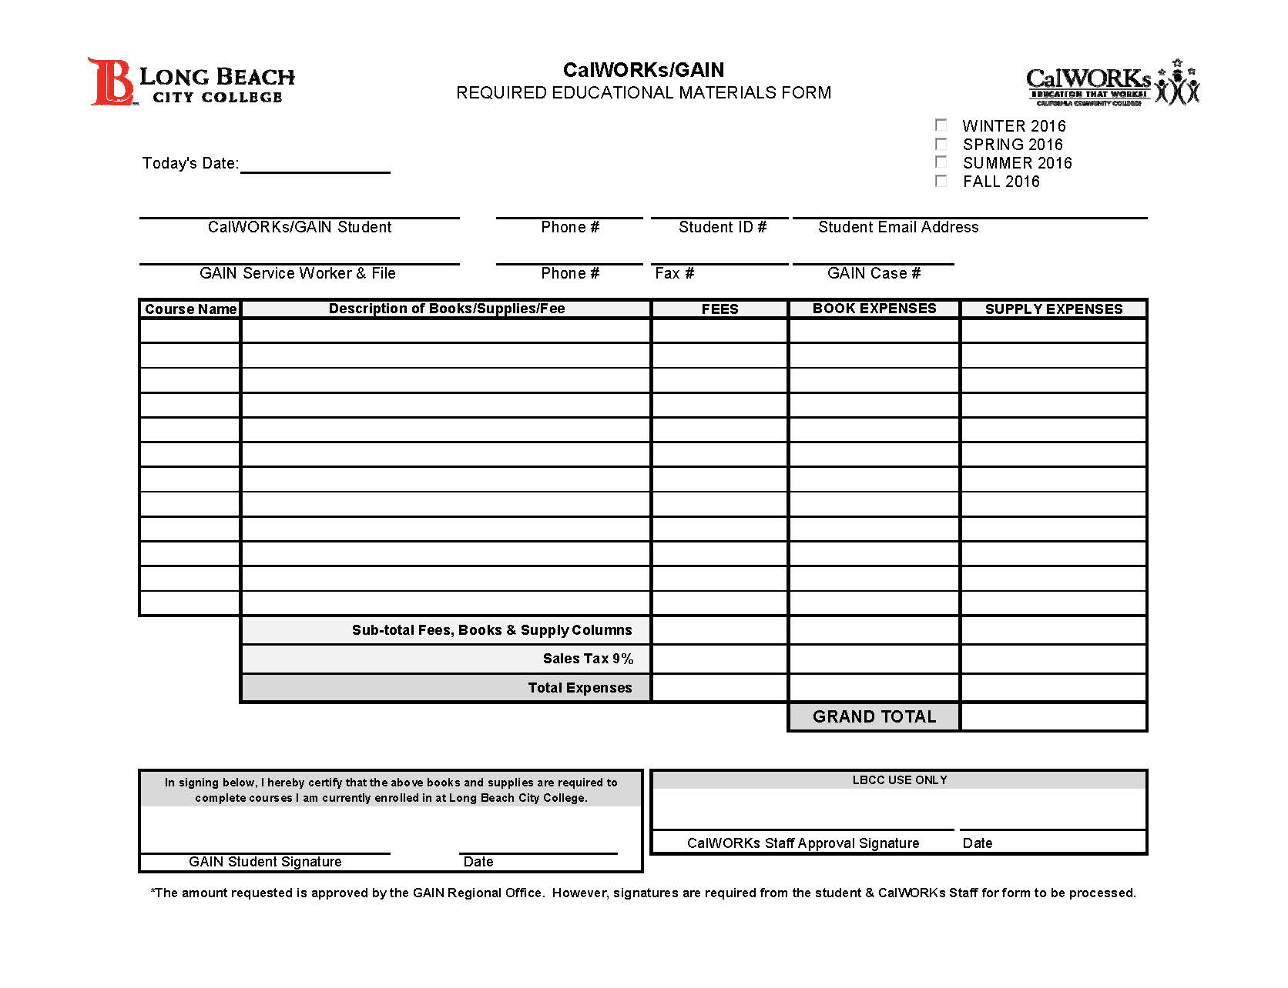
BOOK MATERIAL REQUEST “BMR” GAIN term= “Ancillary Request”
An updated SEP and current semester VOB is REQUIRED for your BMR to be processed by our office.
No exceptions.

Slide 22
Book & Material Request
Textbooks (county will only approve required textbooks)
College Service Card, Health fee, Parking Permit & Material fee
Required uniforms, tools or supply kits for approved majors
School supplies
Other items or fees your major may required

Slide 23
Be Prepared!
Original receipts must be submitted to your GSW/County Worker
Make copies of your receipts for your own records
A print out of your textbooks
A copy of a current class schedule
A copy of your Account Inquiry
student fees: college service card, health , parking, material
A copy of your syllabus for any additional required supplies or tools

Slide 24
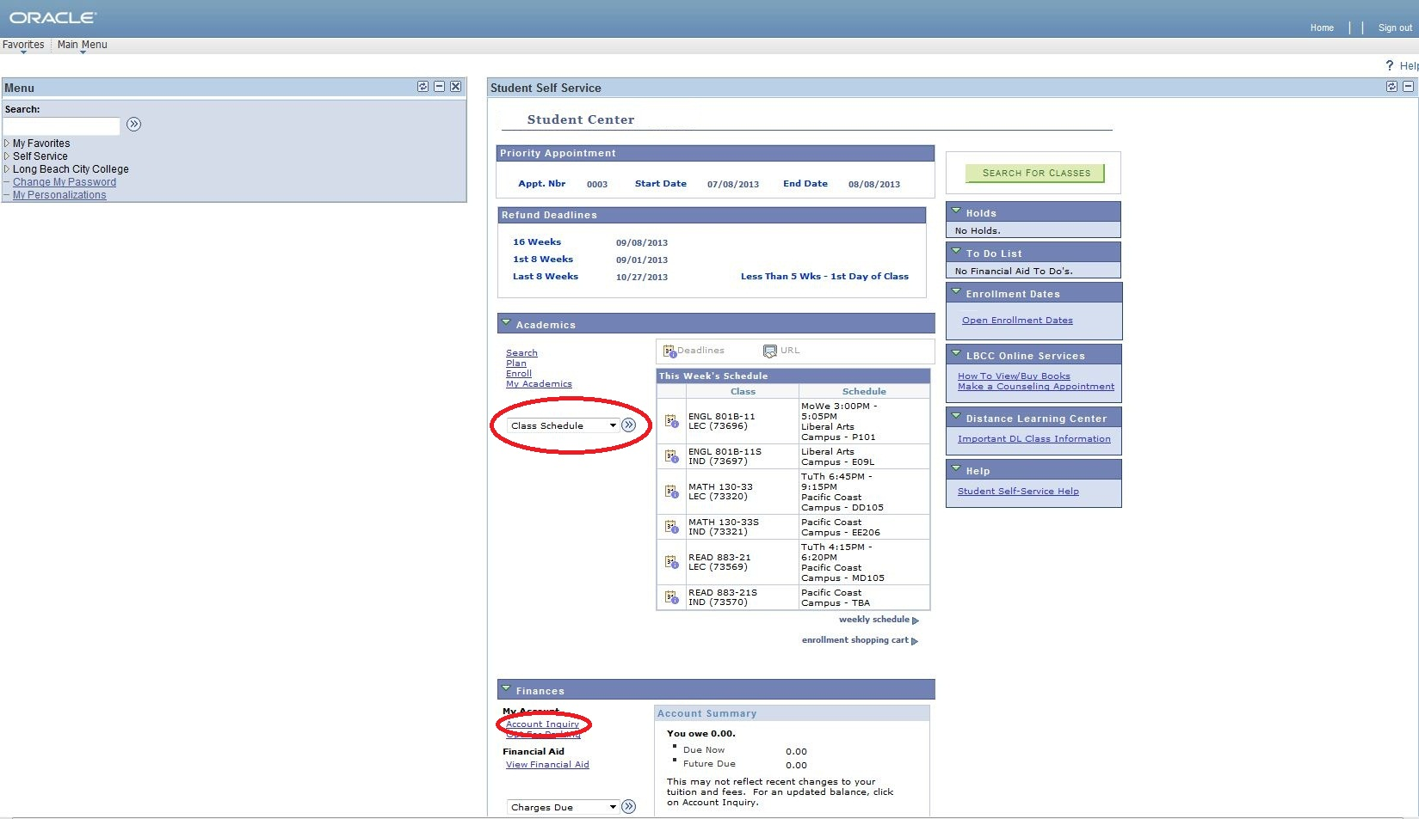
Oracle Login-Class Schedule

Slide 25
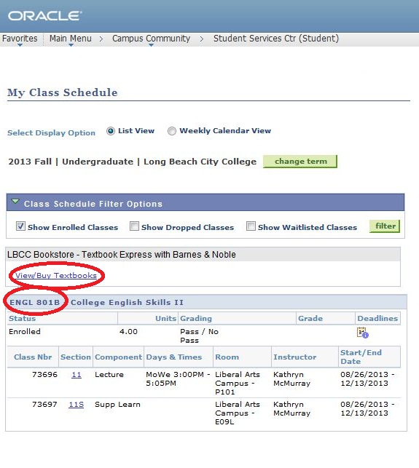
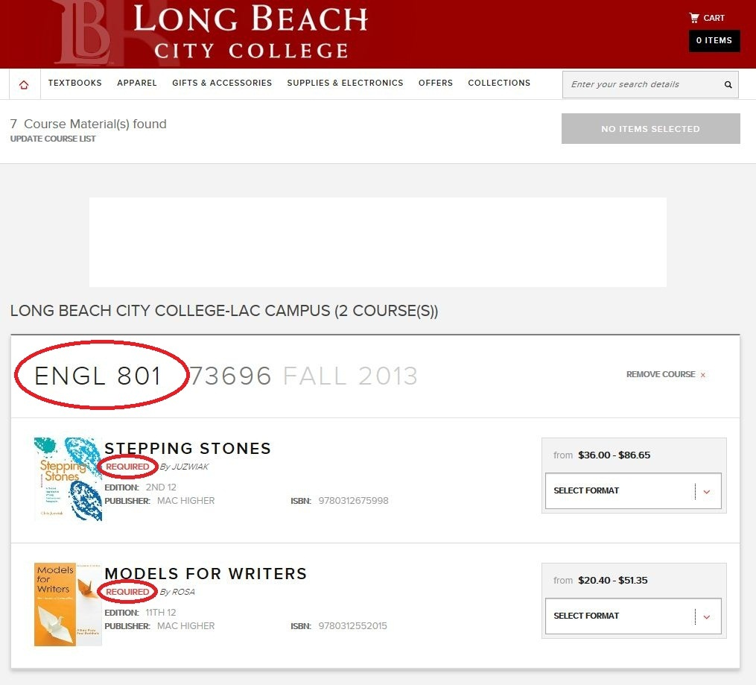
Textbook Print Out
Press “Ctrl+P” to print

Slide 26
Oracle Login-Activity Inquiry

Slide 27
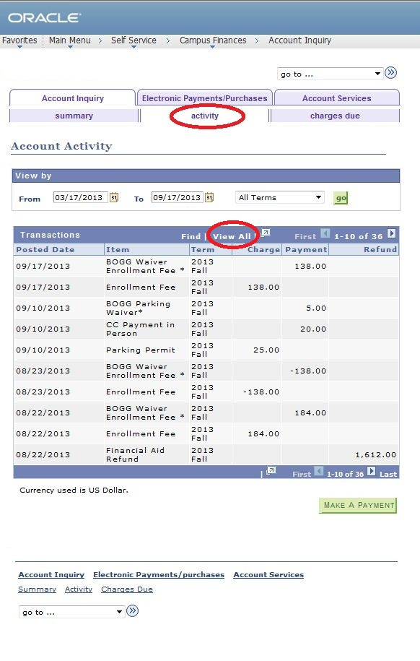
Fee Coverage
BOGW-Tuition
College Service Card (Student ID) Fee
Health Fee
Parking Fee
Material Fee
Press “Ctrl+P” to print

Slide 28
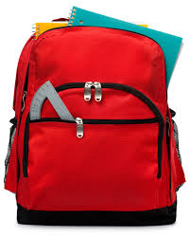
School Supplies
Typical school supplies do not need supporting documentation or receipts for those in LA county ($35.00 allowance). However if there is an item required for the class, then additional documentation (a copy of the syllabus) and receipts will be necessary.
Example: Math 60 (Calculus) requires a scientific calculator-a copy of your syllabus will need to be included
Remember original receipts must be submitted to your GSW

Slide 29
CAREER EXPERIENCE PROGRAM

Slide 30
Career Experience Program
CalWORKs CEP (Career Experience Program) assists students to find subsidized employment opportunities off-campus. It is a work-study program.
What is CEP work-study?
Part-time work for students funded by the California Community Colleges Chancellor’s Office.
Aligned to program of study
Pay rate: minimum federal wage $10/hr. Pay rate up to $20/hr dependent upon skill set and employer partners willingness to pay rate.

Slide 31
Federal Work Study
The Federal Work Study program (also known as FWS or simply Work-Study) is a federally funded program in the United States that assists students with the costs of post-secondary education. The Federal Work Study Program helps students earn financial funding through a part-time work program.
On-campus positions (federal work study) can be secured through Financial Aid and Career Center.
Free Application for Federal Student Aid
https://fafsa.ed.gov/
LBCC Job Service Webpage
http://www.lbcc.edu/Careers/Jobs.cfm

Slide 32
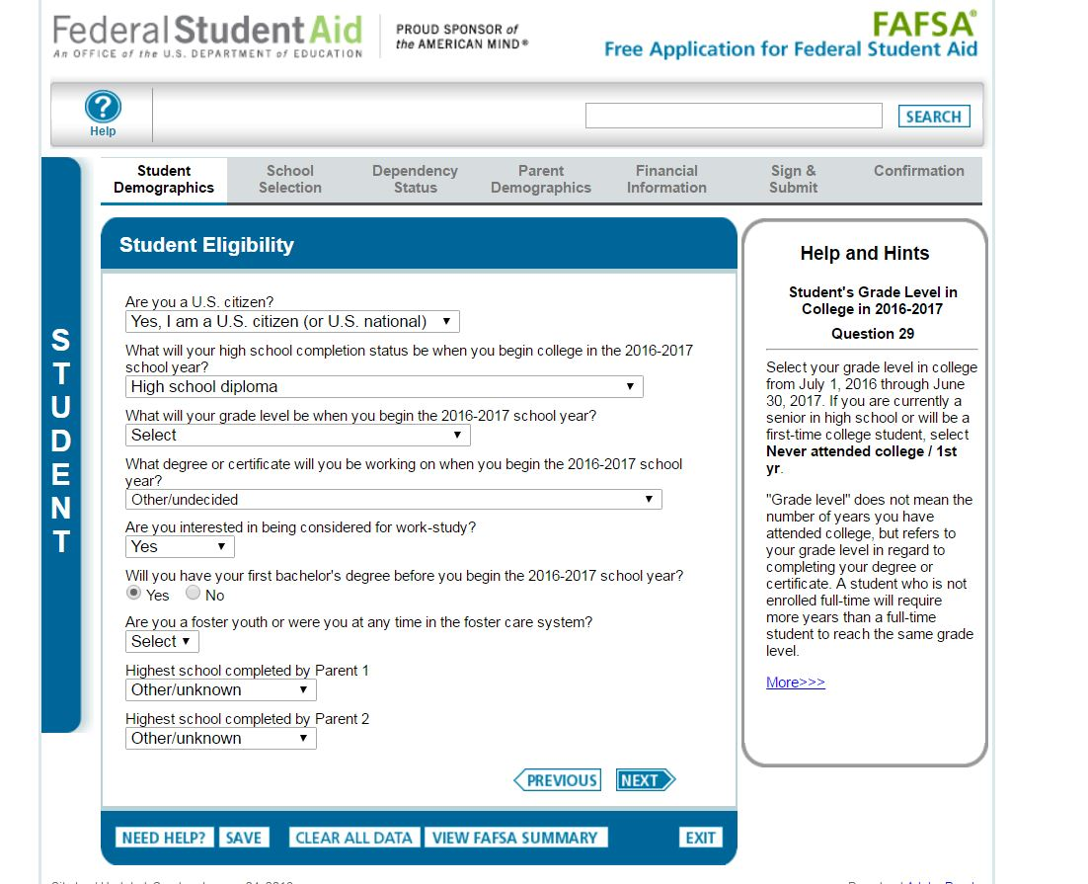
http://fafsa.ed.gov

Slide 33
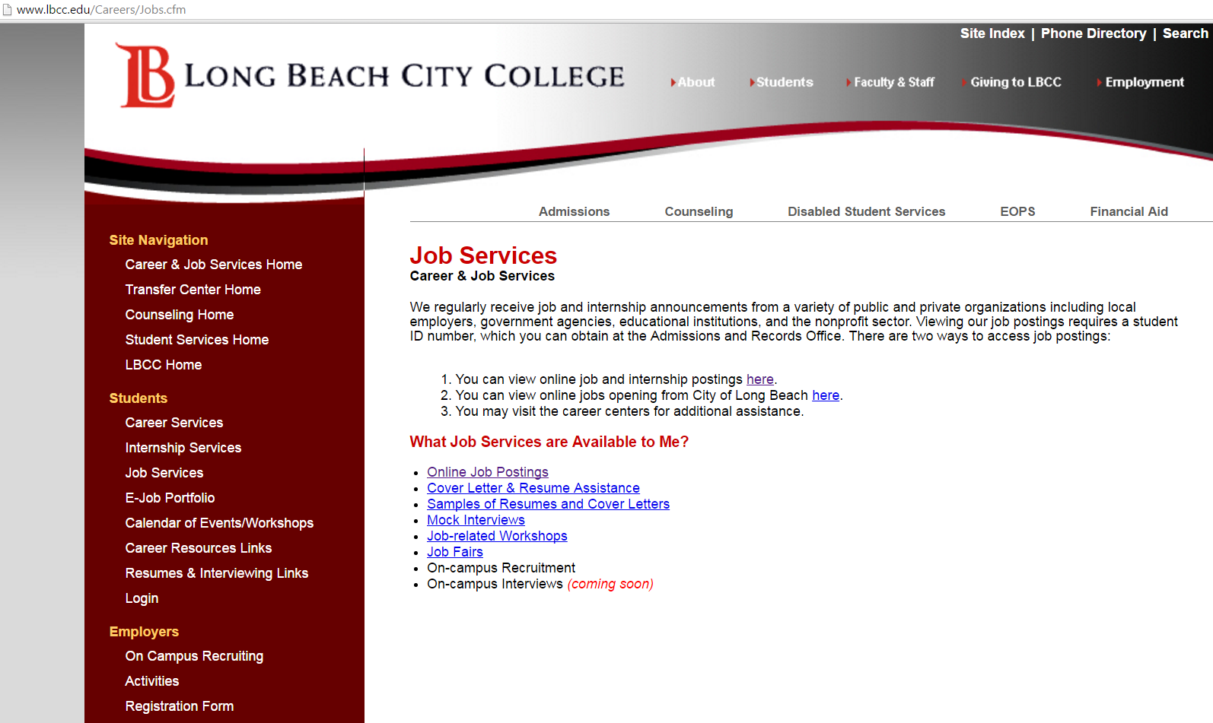
http://www.lbcc.edu/careers/jobs.cfm

Slide 34
Why Work Study?
All income earned under CEP or FWS programs are EXEMPT from cash aid eligibility calculations (MPP Section 44-111.24).
Your timeclock may stop (Senate Bill 1041, ACL 12-67).
Family Type | Federal Hourly Requirements (core hours required)
 | Weekly Hrs. | Core Hrs.
Single-Parent with child under six | 20 hours | Of which 20 hours are in work study
Single-Parent with no child under six | 30 hours | Of which 20 hours are in work study
Two-Parent Family | 35 hours | Of which 30 hours are in work study

Slide 35
Eligibility Requirements
Academic Standards
Maintain good academic standing with a cumulative G.P.A. (grade point average) of 2.0 or better AND 50% of all units attempted.
Maintain enrollment in all your classes throughout the semester.
Minimum 12 units for ON-CAMPUS PLACEMENT
Minimum 6 units for OFF-CAMPUS PLACEMENT
Withdrawal from any course will end your participation in work-study. Schedule modifications that do not deduct from your minimum units is fine.
CalWORKs GAIN Standards
Have an active GAIN contract (verified through CURRENT semester VOB)
Must be within your allotted program time limit “time clock”
Provide a copy of valid California State ID or driver’s license and Social Security card

Slide 36
Suitability Requirements
Comply with CEP and Placement Partner’s Rules and Conduct
Participants will sign an agreement acknowledging Rules and Conduct prior to any placement.
Proof to work* E-verify
Background Check/Livescan Fingerprinting*
Expungement
GAIN has resources for expungement, please feel free to consult with us on how we can assist you.
You should feel free to share with us problem areas so we can assist. All disclosures are confidential and protected under federal law known as FERPA (Family Educational Rights and Privacy Act).
http://www.lbcc.edu/Catalog/ferpa.cfm

Slide 37
Career/Professional Development
Resource
Resume revision/suggestions
Mock Interview/Oral Board Panels
Feedback on Interviews from Partners
One-stop, Resource Boards/Outside Referrals

Slide 38
The goal of the Professional Development Academy is to instill our students with core competencies/transferable skill sets such as: workplace professionalism, business communications etiquette, proficiency in technical skills such as Microsoft Office (Word, Excel, PowerPoint), as well as certifications aligned to their program of study. We believe that these workshops will serve two-fold in refining the skillset of participants which will allow them to:
1) become more effective students
2) become prized candidates in today's competitive job market

Slide 39
Advocate for Assistance
My job
Philosophy
By the numbers:
http://ticas.org/posd/map-state-data-2015#
http://nces.ed.gov/collegenavigator/?q=long+beach+city+college&s=all
http://scorecard.cccco.edu/scorecardrates.aspx?CollegeID=841

Slide 40
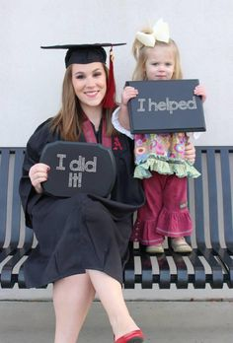
On behalf of ACCESS/CalWORKs
we are excited to welcome you to
Long Beach City College!
This is the beginning of a new journey!
Questions?

