Slide 1
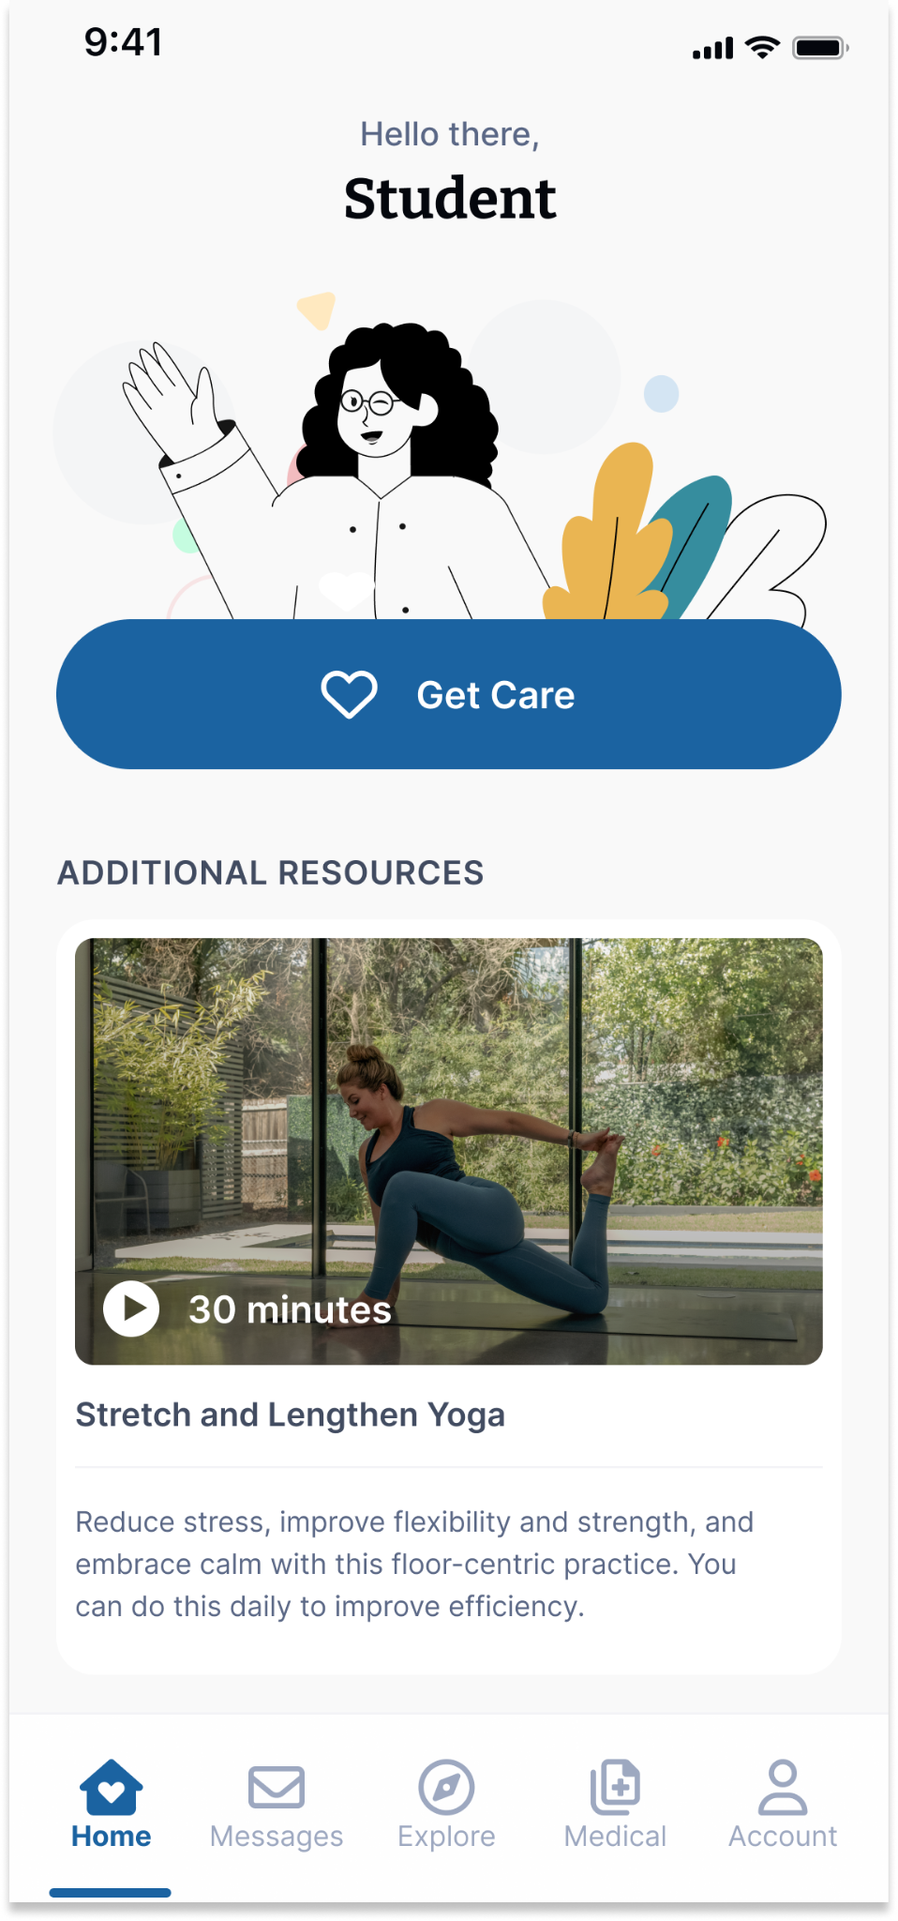
Your Virtual Health and Well-Being Resources
Available on the TimelyCare app or timelycare.com/lbcc
TalkNow
24/7, on-demand emotional support to talk about anything.
Self-Care Content
Visit the “Explore” page for guided self-care content.
Scheduled Counseling
Choose your preferred day, time, and mental health provider.
Basic Needs Support
Access to free or reduced-cost community resources.
Scan the QR Code to access care.
@timelycare
QR CODE HERE
It’s for Students.
@timelycare
FOR FREE.
@timely_care

